Slide 1

DISCLAIMER:
THIS PROPRIETARY ENGINE INVENTION DISCLAIMER SERVES TO DELINEATE THE OWNERSHIP AND PROPRIETARY RIGHTS ASSOCIATED WITH THE ENGINE INVENTION DESCRIBED HEREIN.
OWNERSHIP: THE ENGINE INVENTION DESCRIBED HEREIN, INCLUDING ALL ASSOCIATED DESIGNS, COMPONENTS, AND TECHNOLOGIES, IS THE EXCLUSIVE INTELLECTUAL PROPERTY OF LUKE AMALFITANO. ALL RIGHTS, INCLUDING BUT NOT LIMITED TO PATENTS, COPYRIGHTS, TRADEMARKS, AND TRADE SECRETS, ARE RESERVED BY LUKE AMALFITANO
CONFIDENTIALITY: THE INFORMATION PROVIDED REGARDING THE ENGINE INVENTION IS CONFIDENTIAL AND MAY NOT BE REPRODUCED, DISTRIBUTED, OR DISCLOSED WITHOUT EXPLICIT WRITTEN CONSENT FROM LUKE AMALFITANO.
NON-ENDORSEMENT: ANY MENTION OF THIRD-PARTY PRODUCTS, SERVICES, OR INFORMATION WITHIN THE CONTEXT OF THE ENGINE INVENTION IS FOR ILLUSTRATIVE PURPOSES ONLY AND DOES NOT IMPLY ENDORSEMENT OR RECOMMENDATION BY LUKE AMALFITANO.
LIMITATION OF LIABILITY: LUKE AMALFITANO SHALL NOT BE LIABLE FOR ANY DAMAGES, INCLUDING BUT NOT LIMITED TO DIRECT, INDIRECT, INCIDENTAL, CONSEQUENTIAL, OR PUNITIVE DAMAGES, ARISING OUT OF THE USE OR INABILITY TO USE THE ENGINE INVENTION, EVEN IF ADVISED OF THE POSSIBILITY OF SUCH DAMAGES.
MODIFICATION RIGHTS: LUKE AMALFITANO RESERVES THE RIGHT TO MODIFY, UPDATE, OR DISCONTINUE THE ENGINE INVENTION, OR ANY PART THEREOF, WITHOUT PRIOR NOTICE. SUCH MODIFICATIONS MAY INCLUDE IMPROVEMENTS, ALTERATIONS, OR ADAPTATIONS TO MEET CHANGING TECHNOLOGICAL OR MARKET DEMANDS.
LEGAL ADVICE: THIS ENGINE INVENTION DISCLAIMER DOES NOT CONSTITUTE LEGAL ADVICE. USERS SEEKING LEGAL GUIDANCE REGARDING THE ENGINE INVENTION OR ITS USE SHOULD CONSULT WITH A QUALIFIED ATTORNEY.
BY ACCESSING OR USING ANY INFORMATION RELATED TO THE ENGINE INVENTION, THE USER ACKNOWLEDGES AND AGREES TO ABIDE BY THE TERMS AND CONDITIONS OUTLINED IN THIS DISCLAIMER. LUKE AMALFITANO

Slide 2
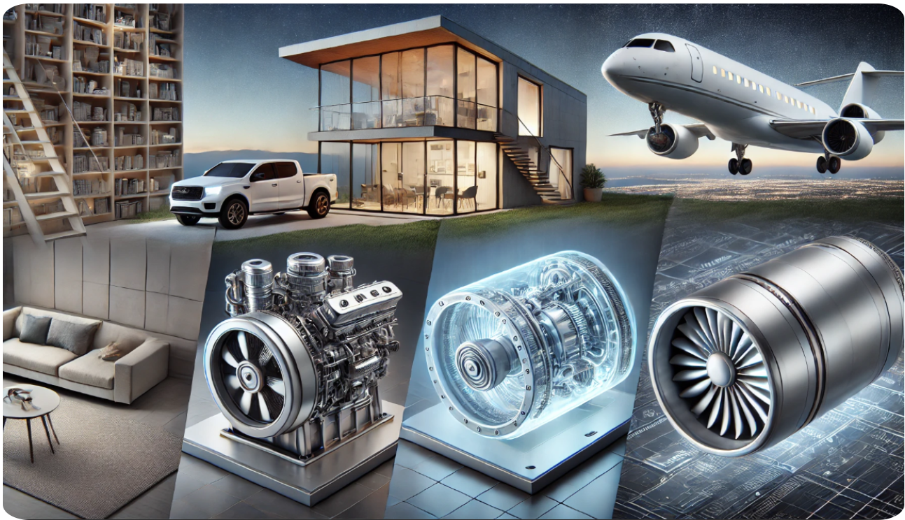

Slide 3
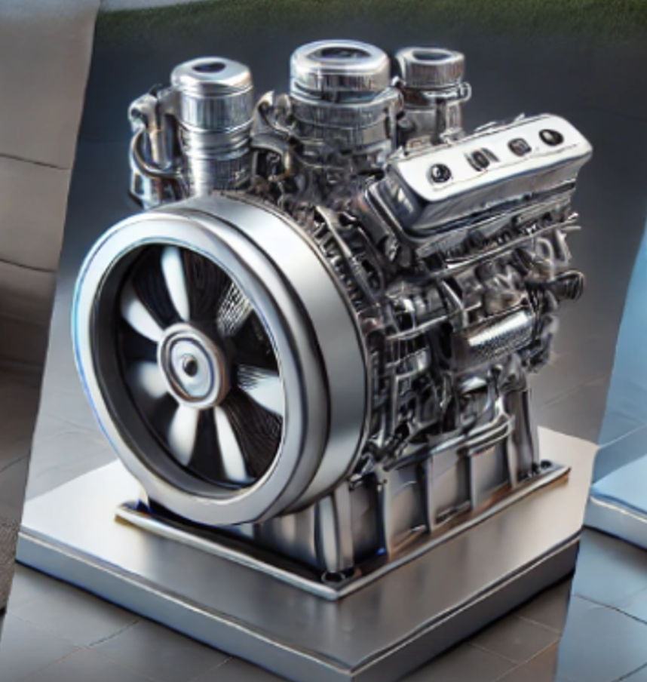
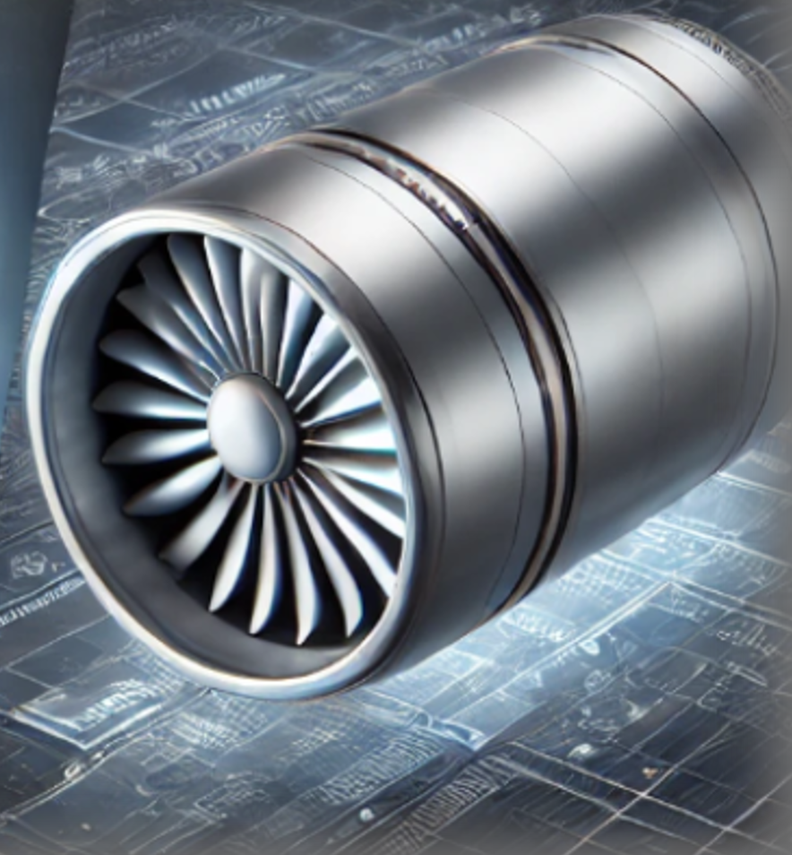
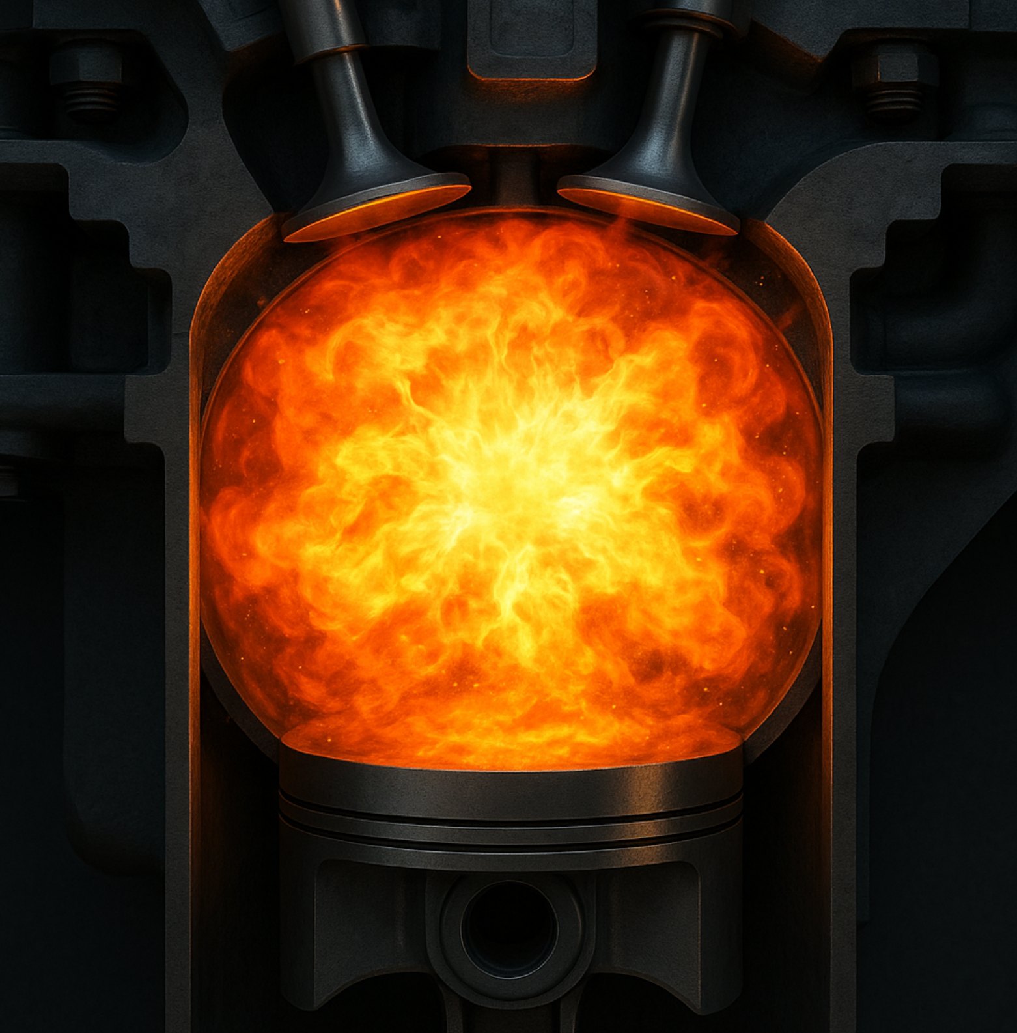
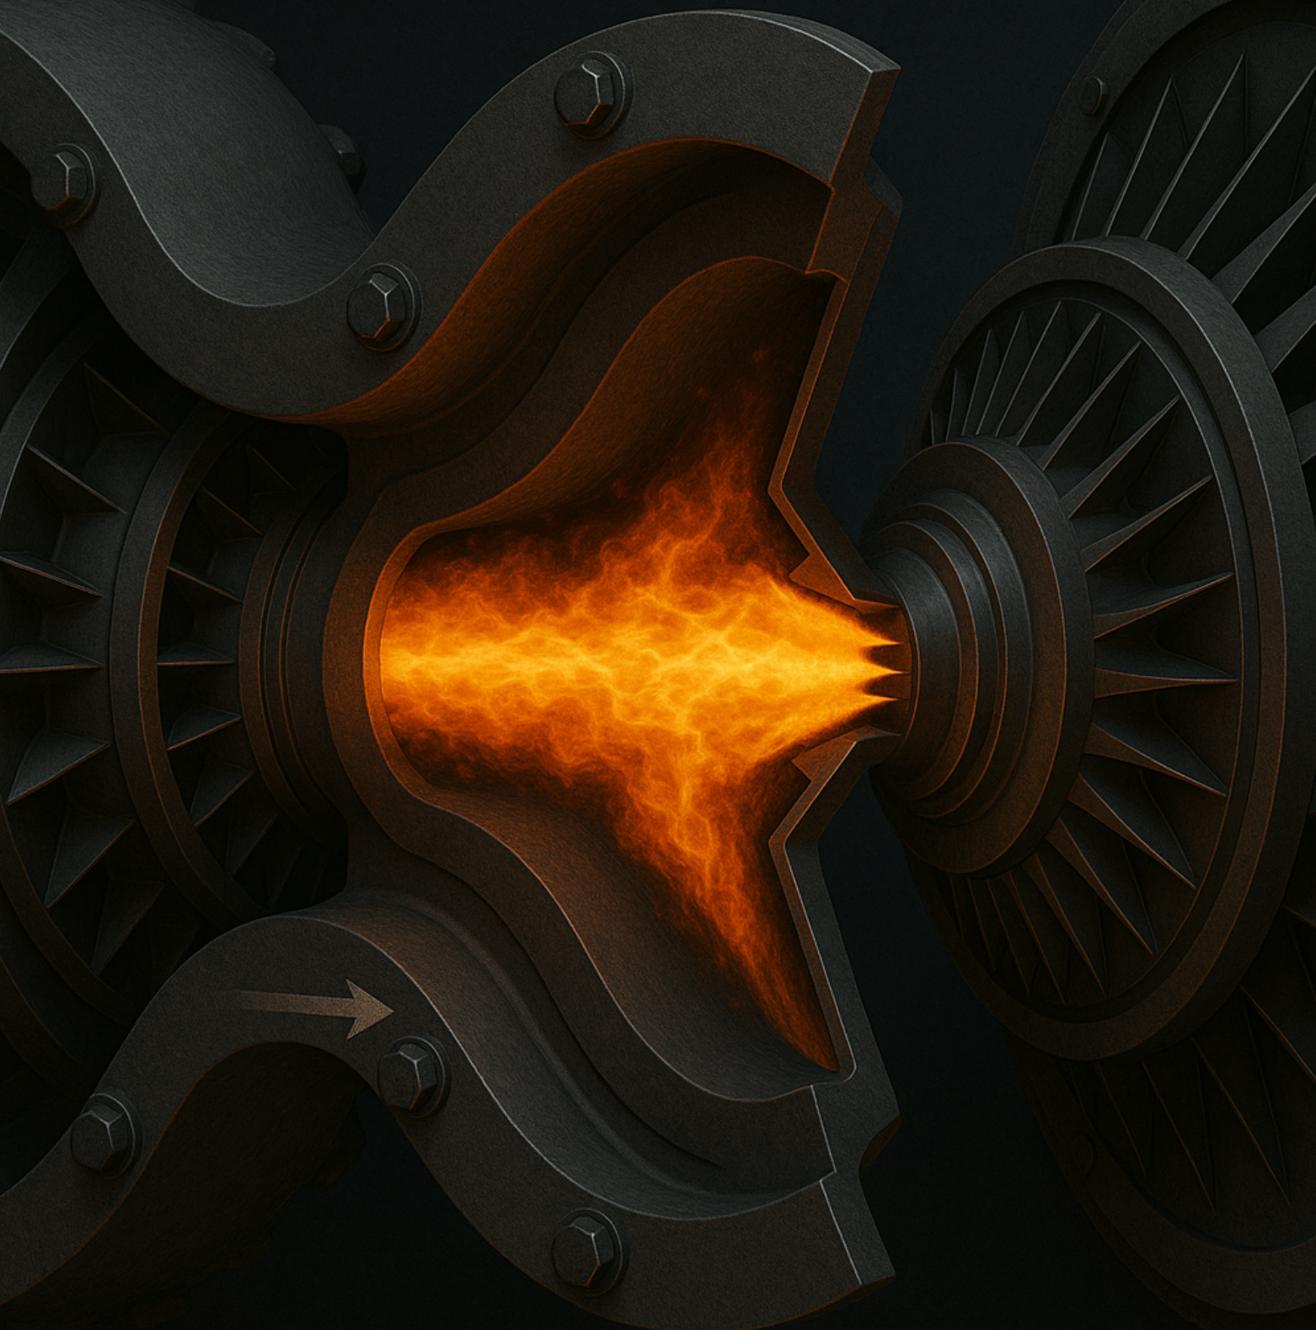
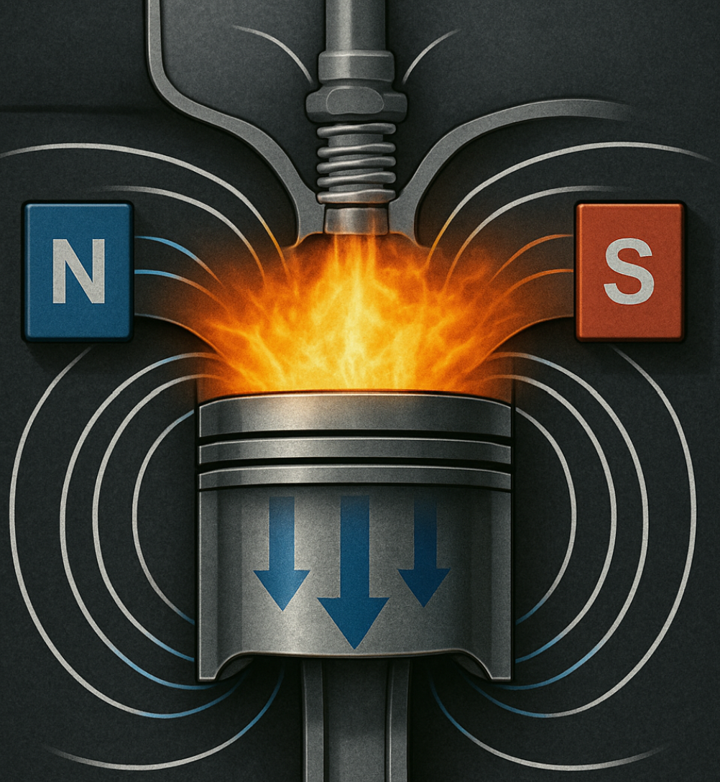
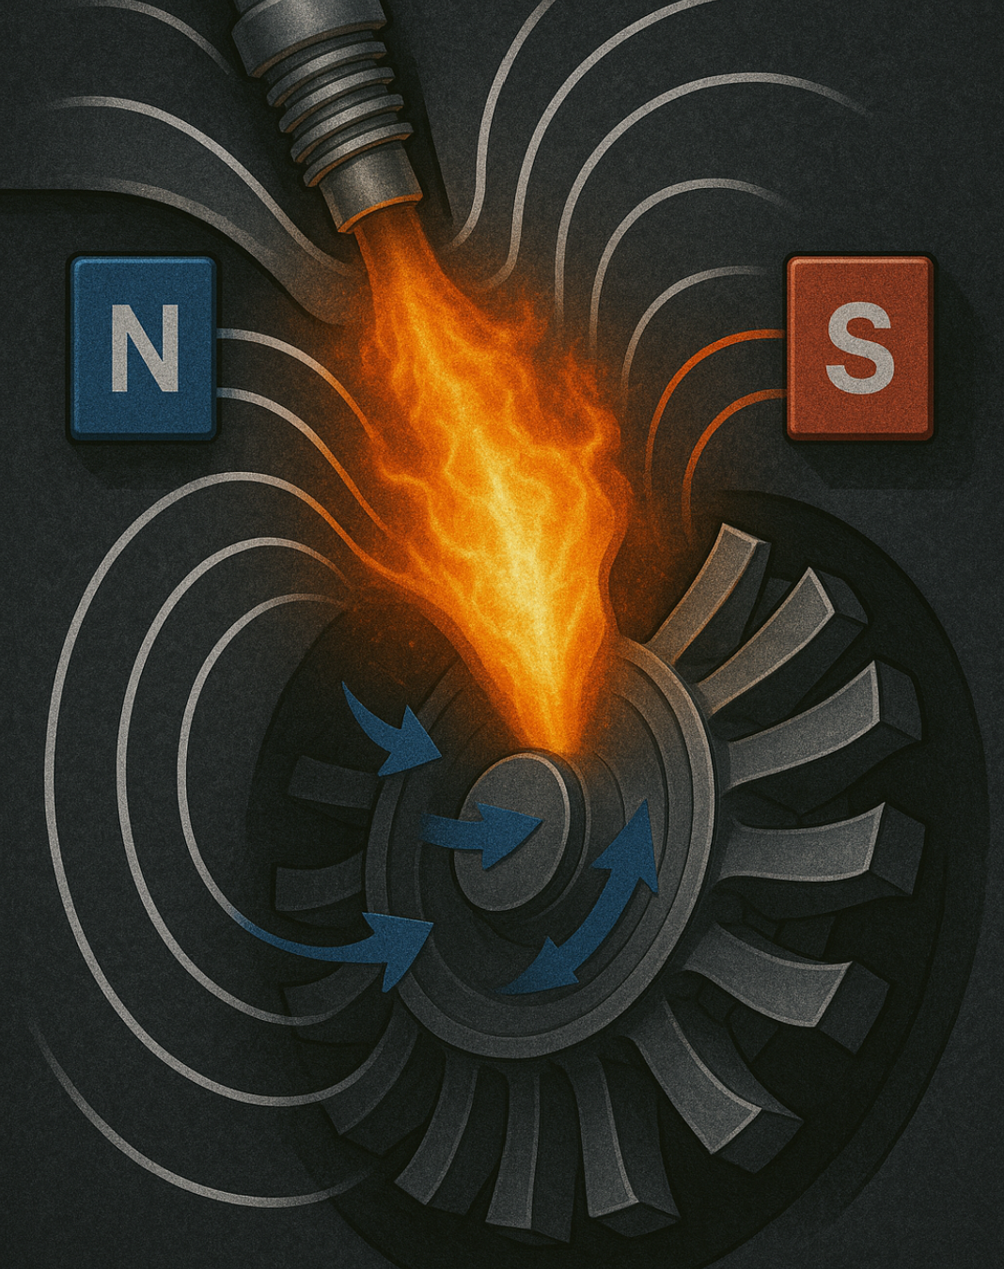






Fundamentals of the Technology (The Heartbeat)
Take this$→$
Take this $→$
Remove Combustion $→$
Remove Combustion $→$
Add Magnetic Fields $→$
Add Magnetic Fields $→$
Systemically, Everything else Remains the Same

Slide 4
I would like to introduce and engine that could change the world.
Executive Summary:
The market opportunity is every combustion engine, and energy source.
This engine has more potential efficiency then any engine ever made.
This engine can produce energy-on-demand for every city, households, traveling vehicles.
The engine is a smarter more cost affective way to free clean sustainable energy. By using traditional methods.

Slide 5
Not a perpetual motion machine (PMM), as we often imagine them, it just isn't possible under the current laws of physics (PMMs are only possible with zero input to the primary energy source). The idea that a machine could run indefinitely without any external energy input goes against the fundamental principles we know, particularly the first and second laws of thermodynamics.
The First Law of Thermodynamics tells us that energy can't be created or destroyed, only transferred or converted. So, for a machine to run forever without any energy input, it would have to break that law.
Then there's the Second Law of Thermodynamics, which says that with every energy transfer, some of that energy is lost, usually as heat, and entropy increases. No system is perfectly efficient, so over time, these small losses would eventually cause the machine to stop.
Now, while the idea of perpetual motion is definitely fascinating, all the designs we've seen so far fail when applied to real-world conditions. Even in highly efficient systems, energy is still lost to things like friction and heat, making it impossible for any machine to run forever. That said, even though my Internal Magnetic Engine (IME) represents a significant step forward in energy efficiency and sustainability, it's still bound by these same thermodynamic laws and needs some form of energy input—so true perpetual motion is off the table.
That being said, the IME offers unlimited range, exceptional efficiency, and zero emissions. With routine maintenance, you'll be able to drive or fly nonstop across the country or even around the world without ever needing to recharge or refuel, for years at a time.
Not A Perpetual Motion Machine (PMM):

Slide 6
The target market is the energy market.
Market Analysis:
The energy market is in trouble with its current sustainable products, my engine can fulfill every facet of the need to replace all current power plants (Power plants meaning engines and actual power plants).
The engine can start with a on demand generator and make its way into every facet of the combustion engine market.
The energy market is a trillion-dollar market.

Slide 7
File #: 16655-001
Intellectual Property Protection:
Inv #: 91595
Application #: 63/690,990
The engine is in its Provisional Patent stage, and currently registered with the USPTO and attorneys Wolter Van Dyke and Davis
https://www.engine16655-001.info/

Slide 8
Generator
Prototype:
Automotive
Turbine
Virtually any power plant can be replaced by this engine

Slide 9
Since this engine is a combination of the already existing engines, there is little to low cost of building.
Risk Management:
Most of the materials needed are readily available for manufacturing.
The combination of the traditional methods makes the engine proven, safe, and effective.
A lot of the materials can be gathered from already refined recycled metals.

Slide 10
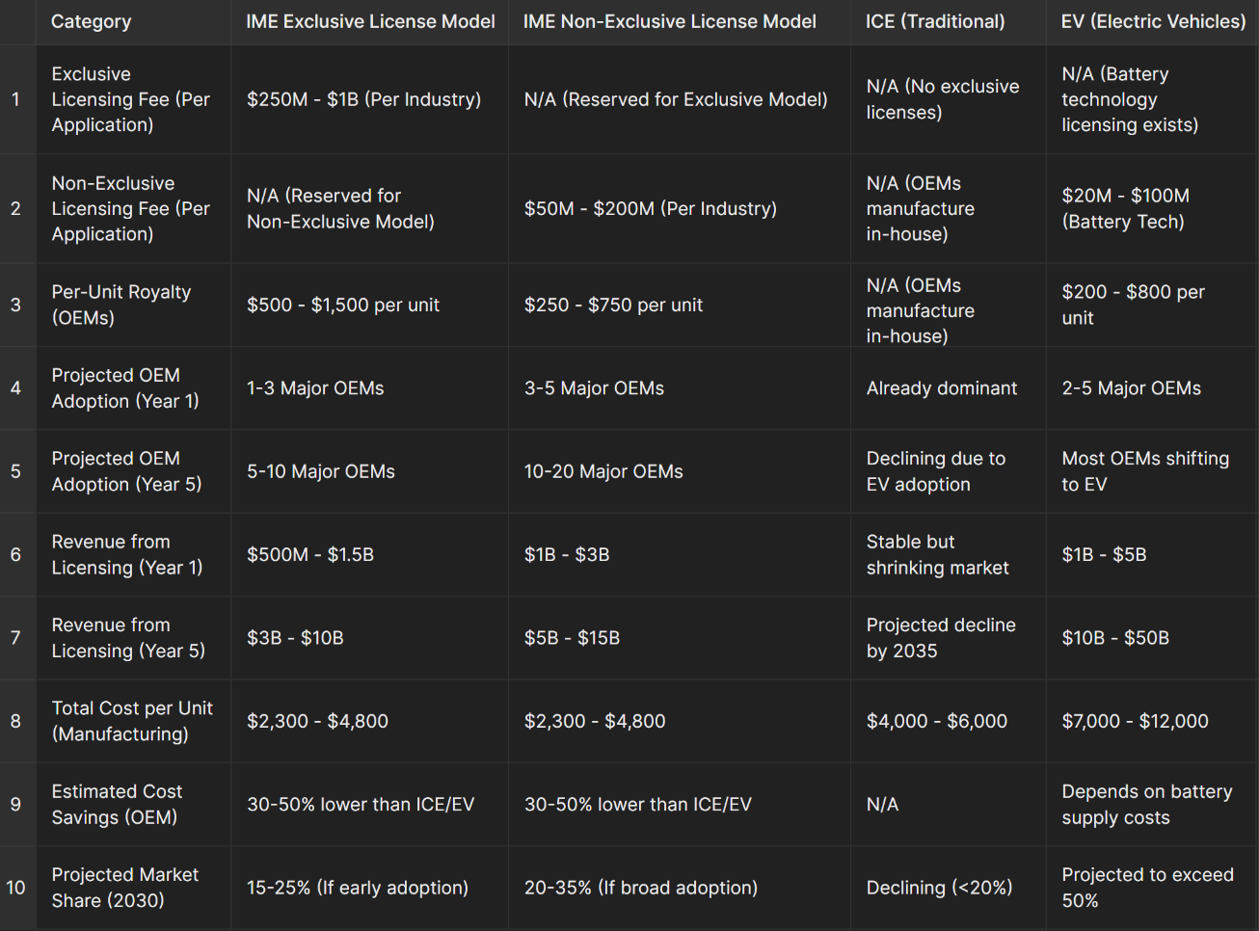
Revenue Model

Slide 11
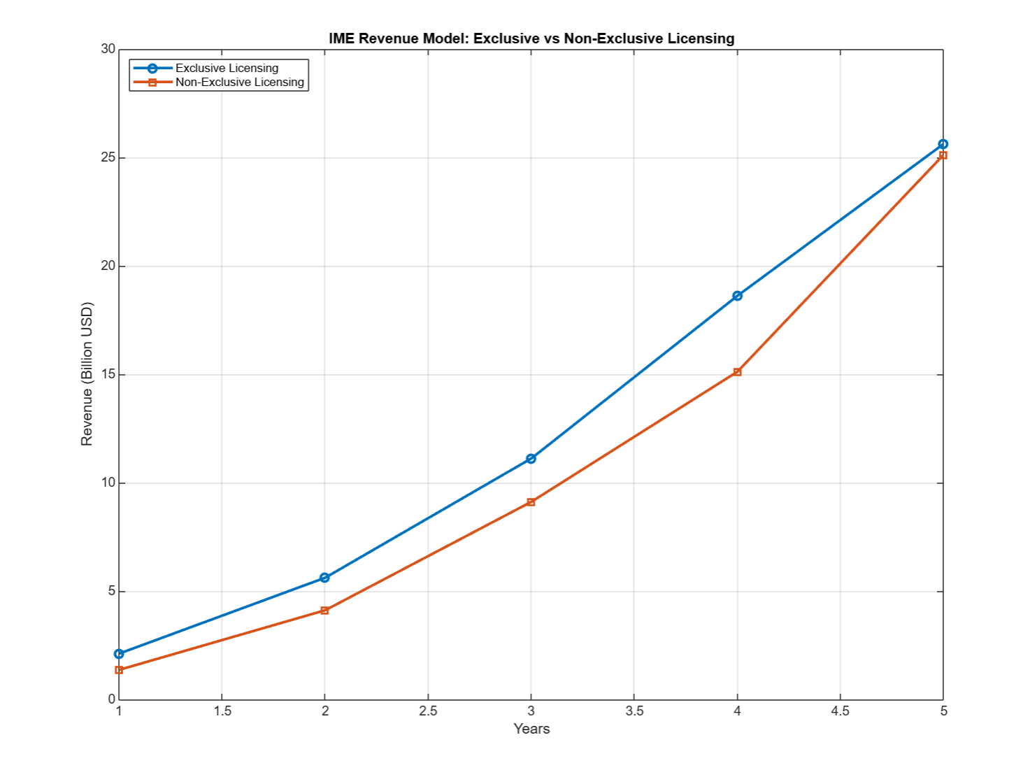
Potential Revenue Model

Slide 12
​ Through the integration of the internal combustion engine (ICE) with its 20-30% efficiency and the electric engine boasting 90% efficiency, a sustainable option known as the Internal Magnetic Engine (IME) emerges, at upward of 100%. This cutting-edge technology eliminates the necessity for traditional fuel sources and achieves zero emissions, all while providing an unparalleled range without reliance on conventional battery cells. Instead, the IME harnesses magnetic forces to power its central shaft, ensuring a on-demand energy supply. By synergizing the strengths of electric and combustion engines, the IME presents a solution characterized by minimal risk and exceptional performance, combining the efficiency of electric propulsion with more inherent sustainability than combustion engines. Furthermore, the IME operates in an ecologically sound manner, generating clean energy in alignment with foundational principles such as Lenz's Law, and Faraday's Law.

Slide 13
The efficiency of this engine is upwards of 100%:
Its Input can be far less than its output creating a surplus of wattage
Depending on the materials used heat is not a factor, side stepping inefficiencies
At 10k scale can power a city, at 100k scale can replace nuclear reactors
Hypersonic speeds are achievable, derived from this engine's thermodynamic benefits.
  For example, thrusting the same temperature air gives a turbine more thrust-per-pound, giving a cleaner more efficient propulsor. Whereas heat from a traditional combustion turbine cuts through air like a knife through butter. Partials moving at higher temperatures also increase entropy. Partials decrease entropy in lower temperatures.

Slide 14
With this engine the customer is guaranteed:
Unlimited Range
Never before seen, truly sustainable Power Plant
Zero Emissions
Better Performance
Better Efficiency

Slide 15
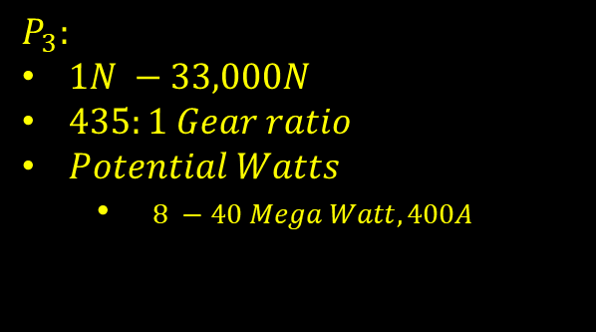
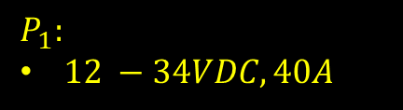
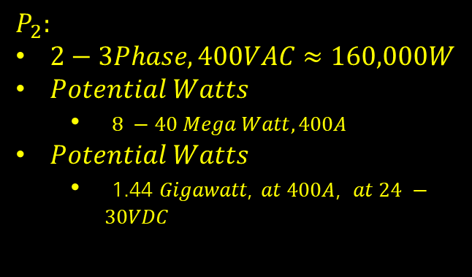


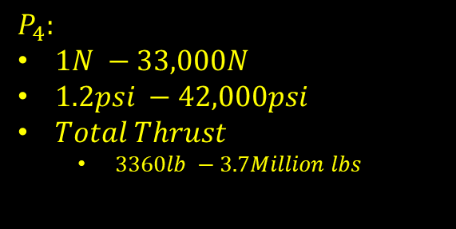


Block Diagram
$$P_{2}$$
DC Battery
$$P_{4}$$
Starter Generator
$$P_{1}$$
Electric Engine
Propulsor
Alternator
$$P_{3}$$
$$P_{1}:$$
$12 −34VDC, 40A$
$$P_{2}:$$
$2−3Phase, 400VAC≈160,000W$
𝑃𝑜𝑡𝑒𝑛𝑡𝑖𝑎𝑙 𝑊𝑎𝑡𝑡𝑠
  $8 −40 Mega Watt, 400A$
𝑃𝑜𝑡𝑒𝑛𝑡𝑖𝑎𝑙 𝑊𝑎𝑡𝑡𝑠
  1.44 𝐺𝑖𝑔𝑎𝑤𝑎𝑡𝑡, $at 400A$, 𝑎𝑡 $24 −30VDC$
$$P_{3}:$$
$1N −33,000N$
$435:1 Gear ratio$
𝑃𝑜𝑡𝑒𝑛𝑡𝑖𝑎𝑙 𝑊𝑎𝑡𝑡𝑠
  $8 −40 Mega Watt, 400A$
$$P_{4}:$$
$1N −33,000N$
$1.2psi −42,000psi$
$Total Thrust$
  $3360lb −3.7Million lbs$

